Slide 1

Country Explorer Web Application
Presented by: NPRANAVI SAI
B.Tech CSE
Using HTML, CSS, JavaScript & REST Countries API

Slide 2


Project Introduction: Navigating the Globe Digitally
This project introduces the Countries Explorer, a dynamic client-side web application designed to simplify access to global country information.
Users can effortlessly search for countries by name, code, continent, and capital, all by consuming a public REST API. This application serves as a practical demonstration of handling REST APIs, processing data with JavaScript, and rendering an intuitive user interface without relying on a backend.
Key Focus: Understanding client-side web development through real-world API integration.

Slide 3


Project Objectives & Solution Overview
Display Country List
Present a comprehensive list of all countries.
Multi-Criteria Search
Enable searching by name, code, continent, and capital.
Real-Time Data
Utilize real-time data from a robust API.
Responsive UI
Ensure optimal viewing across all devices.
Our solution is a responsive web application that fetches real-time country data and provides intuitive search functionalities, simplifying geographical exploration.

Slide 4
Core Technologies Powering the Explorer
HTML5
CSS3 / Bootstrap
JavaScript (ES6)
REST Countries API
Structuring the web content and ensuring semantic organization.
Styling the application for a modern and responsive user experience.
Handling dynamic data, API calls, and interactive UI elements.
The primary data source for all country-related information.
Git & GitHub
Version control and collaborative development platform.

Slide 5

Understanding the Application Architecture
User Interface
Fetch API
REST Countries
JSON Response
The architecture illustrates the client-side flow: users interact with the UI, which triggers JavaScript to fetch data from the REST Countries API. The API responds with JSON data, which JavaScript then processes and renders dynamically back onto the web page.

Slide 6

Why REST Countries API?
1
Free & Public
Accessible to all developers without cost.
2
Real-World Data
Provides up-to-date and accurate country information.
3
No Authentication
Simplifies integration, no complex setup required.
4
JSON Format
Easy to parse and manipulate with JavaScript.
REST (Representational State Transfer) is an architectural style that allows systems to communicate over HTTP. In this project, we specifically use GET requests to fetch country data, adhering to RESTful principles.

Slide 7



Addressing API Changes: The Deprecation of restcountries.eu
Initially, development resources might have pointed to http://restcountries.eu/. However, this API is now deprecated and no longer actively maintained. Attempts to use it will result in errors or incomplete data.
The currently supported and recommended API endpoint is https://restcountries.com. It's vital to note that this new API uses a different response structure, meaning older code examples or tutorials based on the deprecated version will not function correctly without modification.
Important: Always verify API documentation for the most current endpoints and data structures to avoid integration issues.

Slide 8


Optimizing API Usage with the fields Parameter
To enhance performance and reduce unnecessary data transfer, I implemented an optimization strategy using the fields parameter in the API request.
https://restcountries.com/v3.1/all?fields=name,cca2,region,capital,flags
This approach allows us to selectively request only the data crucial for our application, such as name, country code (cca2), region, capital, and flags. By doing so, we significantly reduce the payload size, which translates to faster load times and a more responsive user experience.
Benefit: Smaller data payloads lead to quicker responses and lower bandwidth consumption, especially critical for mobile users.

Slide 9
Project Structure: Keeping It Organized
Country-Explorer/
The root directory housing all project files for our web application.
index.html
The main HTML file, defining the application's structure and user interface.
style.css
Cascading Style Sheets for visual presentation and responsive design.
script.js
The core JavaScript logic, handling data fetching, display, and filtering.
README.md
Documentation for the project, including setup instructions and usage.

Slide 10

JavaScript Core Functions
Our application's interactivity is powered by three primary JavaScript functions, each responsible for a crucial part of the user experience.
fetchCountries()
displayCountries()
filterCountries()
Initiates the API call and retrieves country data.
Renders the fetched data onto the web page.
Dynamically updates the displayed list based on user input.

Slide 11

Fetching Data: The `fetchCountries` Function
async function fetchCountries() {
const response = await fetch(
"https://restcountries.com/v3.1/all?fields=name,cca2,region,capital,flags"
);
countriesData = await response.json();
displayCountries(countriesData);
}
This asynchronous function is responsible for making the API request. It fetches all country data from the specified endpoint, parses the JSON response, and then passes this data to the displayCountries function for rendering.

Slide 12
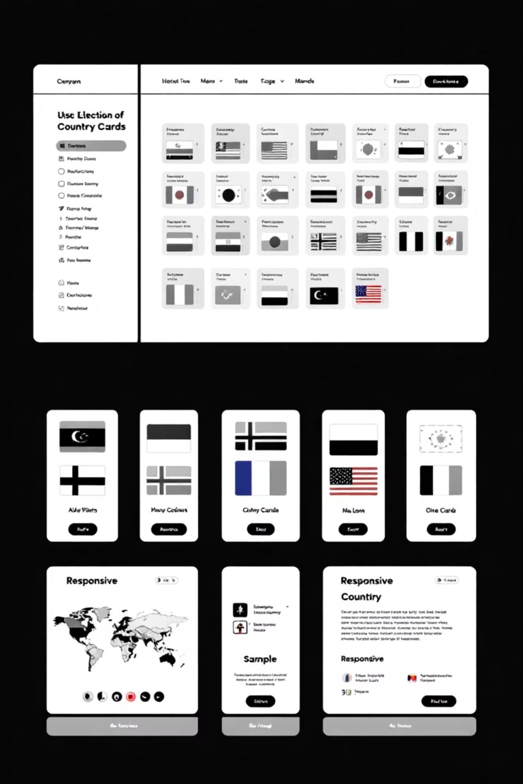
Displaying Results: The `displayCountries` Function
function displayCountries(countries) {
const list = document.getElementById("countriesList");
list.innerHTML = "";
countries.forEach(country => {
const card = document.createElement("div");
card.className = "col-md-4 country-card";
card.innerHTML = `
<h5>${country.name.common}
<img src="${country.flags.png}">
<p><b>Code:</b> ${country.cca2}
<p><b>Continent:</b> ${country.region}
<p><b>Capital:</b> ${country.capital?.[0] || "N/A"}
`;
list.appendChild(card);
});
}
This function dynamically generates HTML elements to display each country's information. It iterates through the countries array, creating a "card" for each country, complete with its common name, flag, CCA2 code, region, and capital. These cards are then appended to the countriesList container.

Slide 13

Filtering Data: The `filterCountries` Function
function filterCountries() {
const name = searchName.value.toLowerCase();
const code = searchCode.value.toLowerCase();
const continent = searchContinent.value.toLowerCase();
const capital = searchCapital.value.toLowerCase();
const filtered = countriesData.filter(country =>
country.name.common.toLowerCase().includes(name) &&
country.cca2.toLowerCase().includes(code) &&
country.region.toLowerCase().includes(continent) &&
(country.capital?.[0]?.toLowerCase().includes(capital) || capital === "")
);
displayCountries(filtered);
}
The filterCountries function takes user input from various search fields (name, code, continent, capital) and applies a filter to the countriesData. It performs case-insensitive comparisons to match countries that include the search terms. The filtered results are then passed to displayCountries to update the UI.

Slide 14

Real-time Interactivity: Event Handling
Input Event Listeners
Each search input field is equipped with an "input" event listener.
Real-time Search
This allows for instantaneous filtering and updating of the country list as the user types, without requiring a full page reload.
searchName.addEventListener("input", filterCountries);
searchCode.addEventListener("input", filterCountries);
searchContinent.addEventListener("input", filterCountries);
searchCapital.addEventListener("input", filterCountries);

Slide 15


Deployment: Sharing Our Creation
Code Pushed to GitHub
Deployed Using GitHub Pages
The entire project codebase is hosted on GitHub, enabling version control, collaboration, and easy access.
The web application is deployed directly from the GitHub repository using GitHub Pages, providing a simple and free hosting solution for our static site.

Slide 16
Key Learnings & Future Enhancements
Understanding Large JSON Structures
1
Navigating and parsing extensive JSON responses from APIs can be complex but is crucial for effective data utilization.
Effective API Exploration
2
Thoroughly reviewing API documentation and experimenting with endpoints is vital for successful integration.
Implementing Efficient Filtering Logic
3
Optimizing search algorithms ensures a smooth and responsive user experience, even with large datasets.

